Slide 1
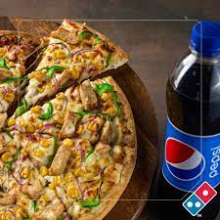
How can we take multiple pizza orders and check if they’re valid without rewriting the code each time?

Slide 2
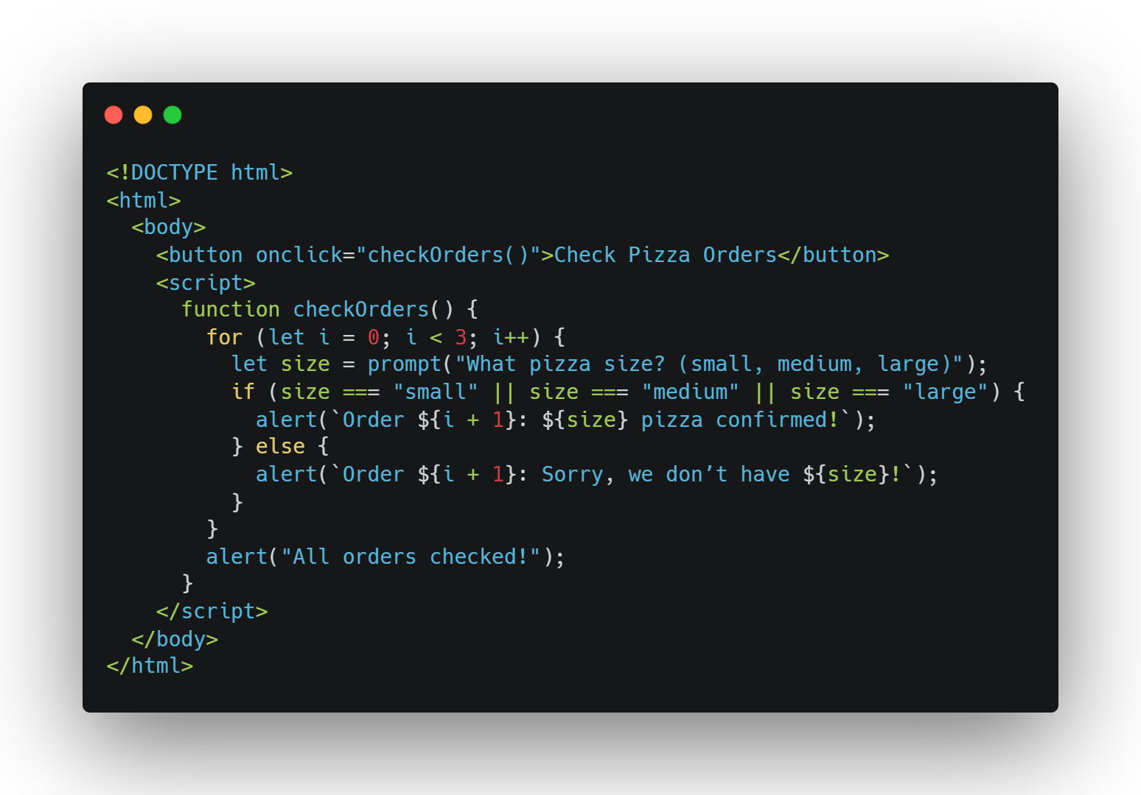
How can we take multiple pizza orders and check if they’re valid without rewriting the code each time?

Slide 3
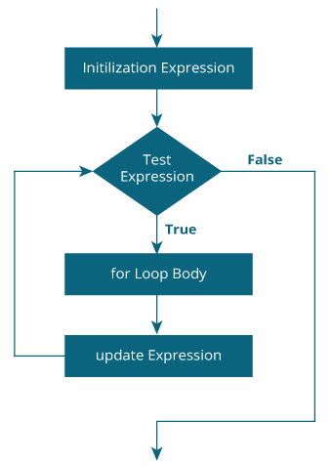
For loops
What’s a for Loop?
It repeats code a certain number of times, like counting to 5.
Perfect when you know how many times to repeat

Slide 4
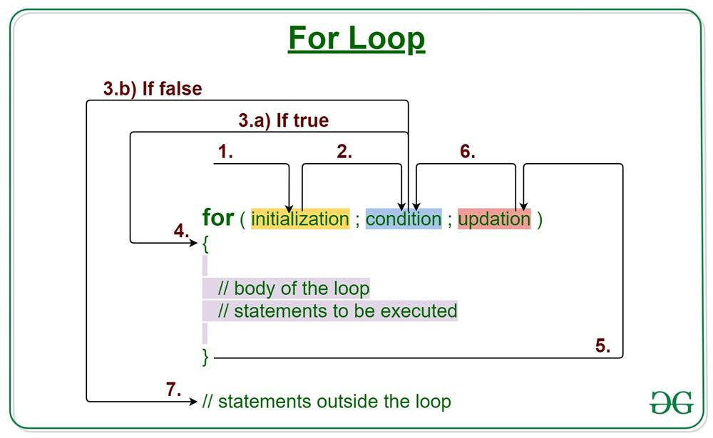

Slide 5
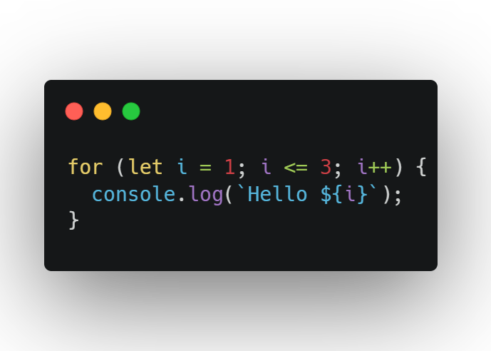
Flow:
let i = 1: Start at 1.
i <= 3: Keep going until i is 3.
i++: Add 1 each time.

Slide 6

Why Use It?
Show 5 items on a website.
Count points in a game.
Print numbers for a quiz.

Slide 7
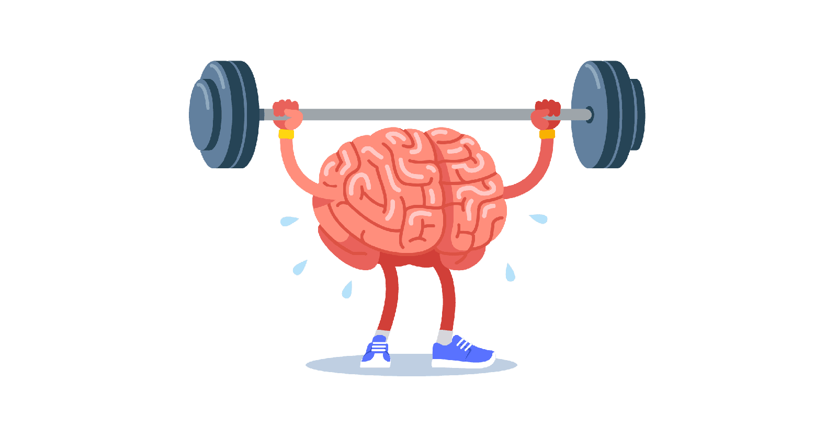
Exercise

Slide 8
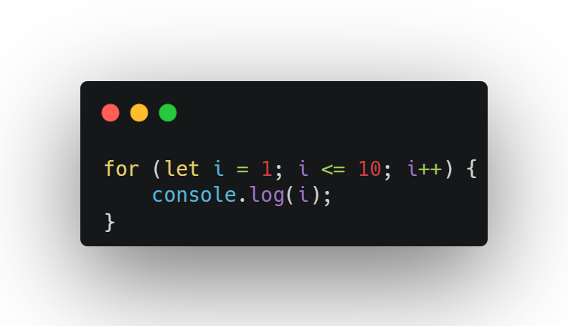
Question 1:

Slide 9
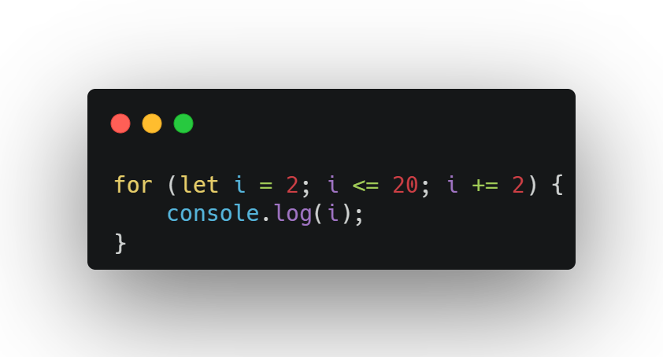
Question 2:

Slide 10
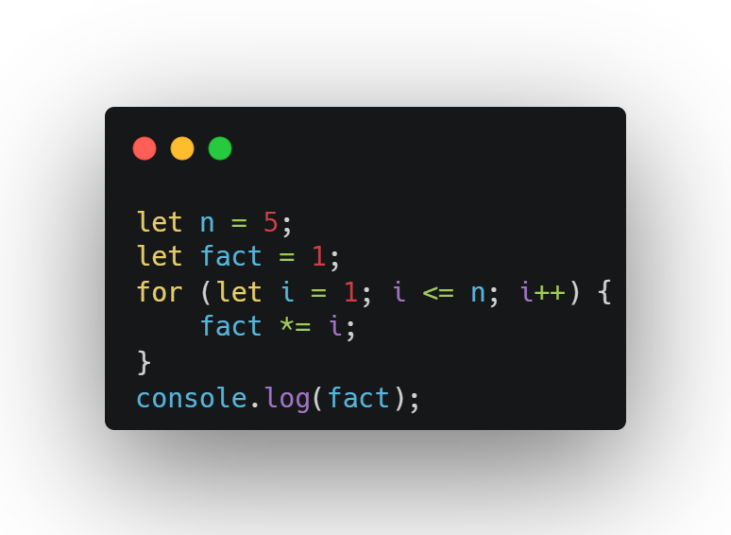
Question 3:

Slide 11
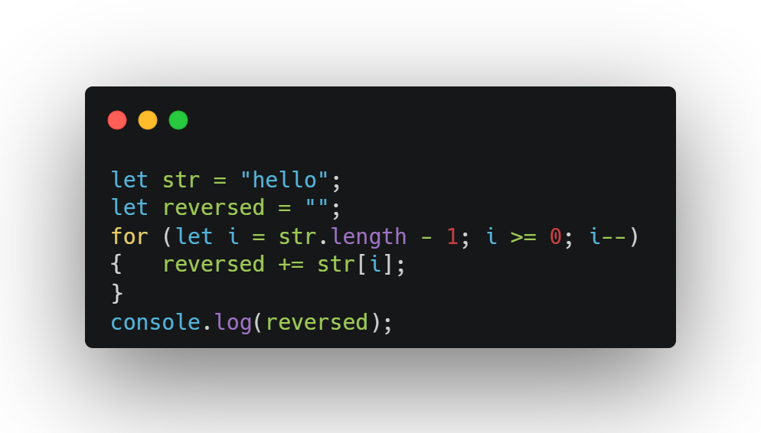
Question 4:

Slide 12
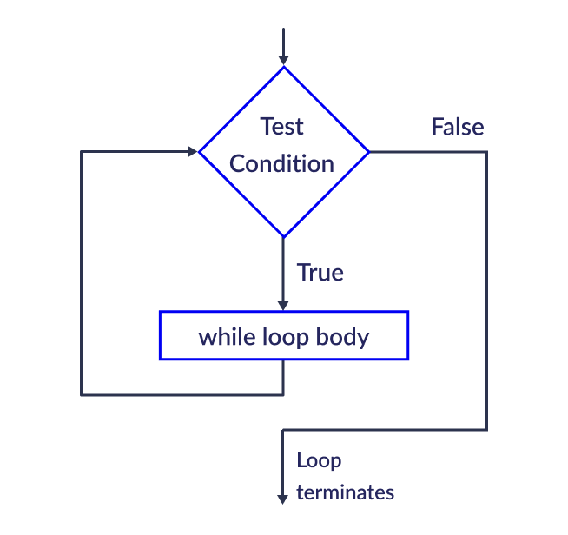
While Loop
Repeats as long as something is true, like waiting for your turn.
Good when you don’t know how many times you’ll repeat.

Slide 13
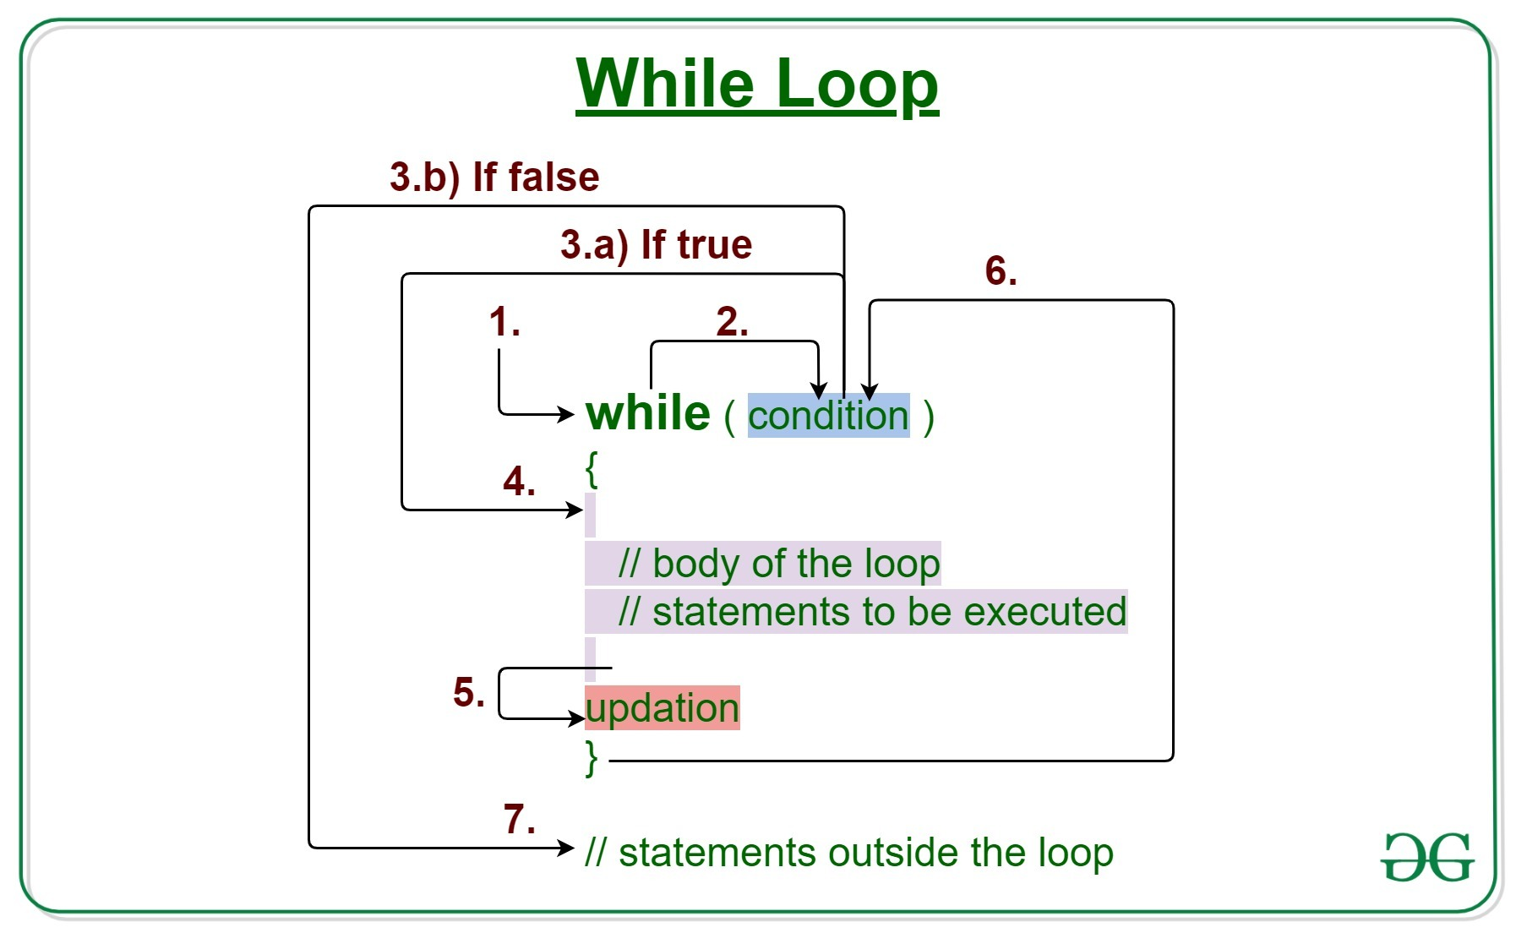
While Loop

Slide 14
Exercise

Slide 15
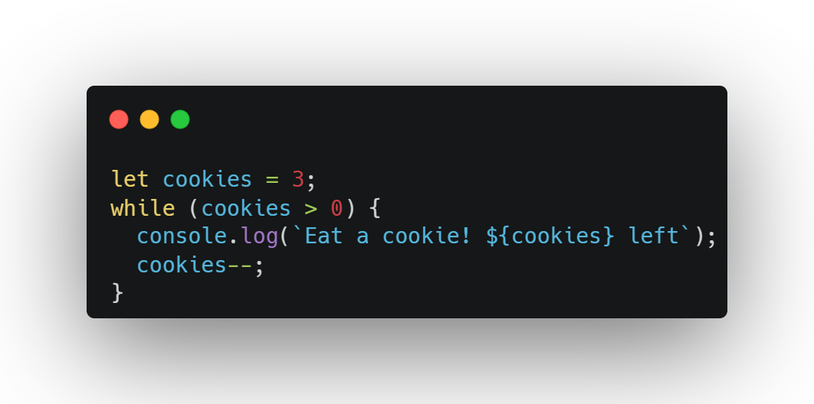
While Loop

Slide 16
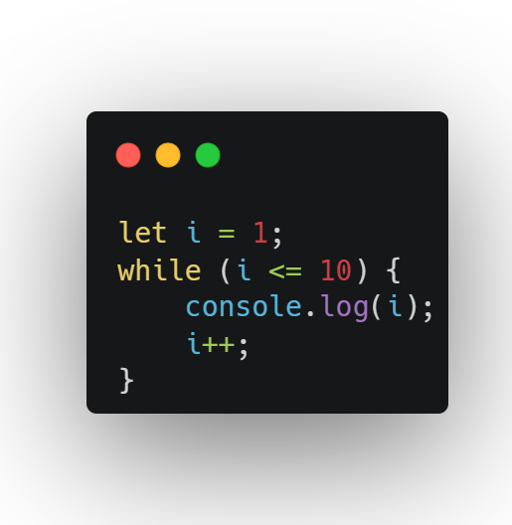
Question 1:

Slide 17
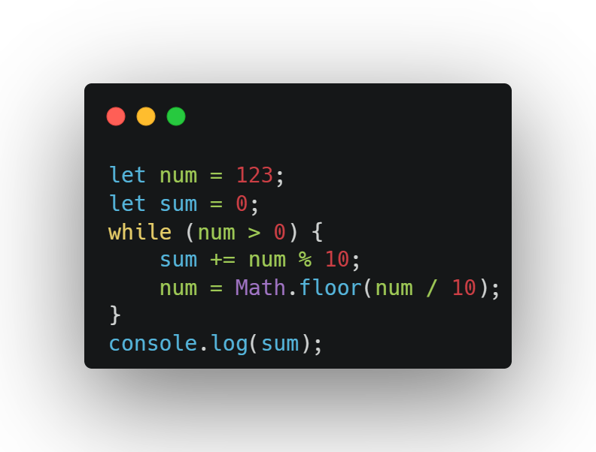
Question 2:

Slide 18
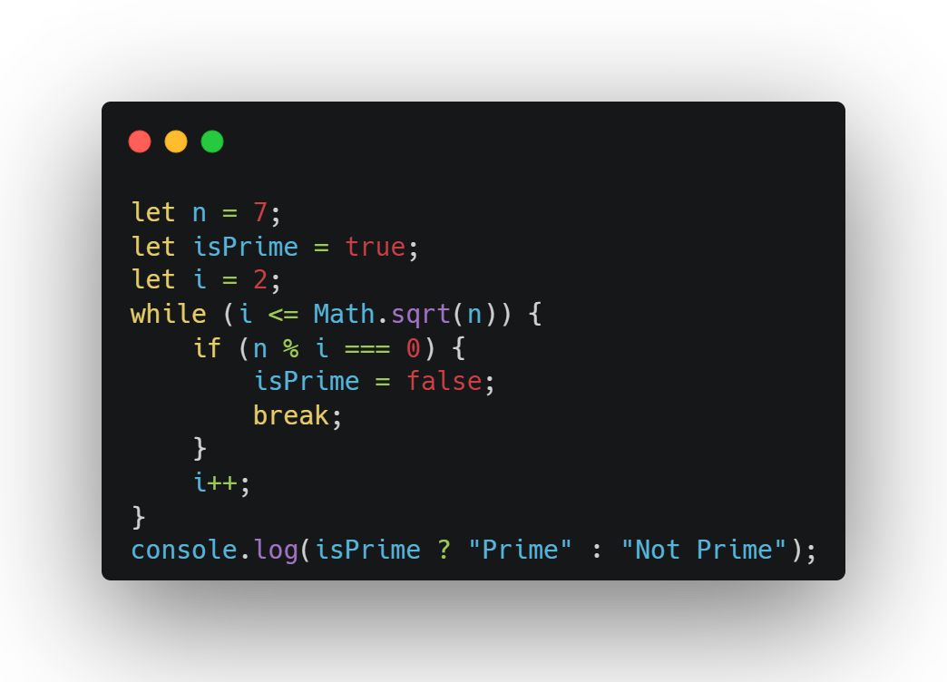
Question 3:

Slide 19
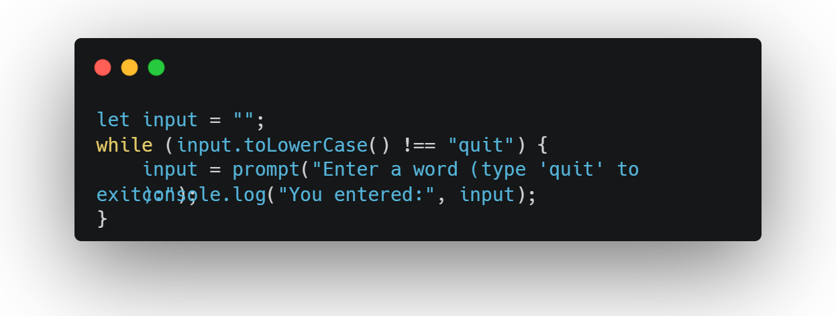
Question 4:

Slide 20
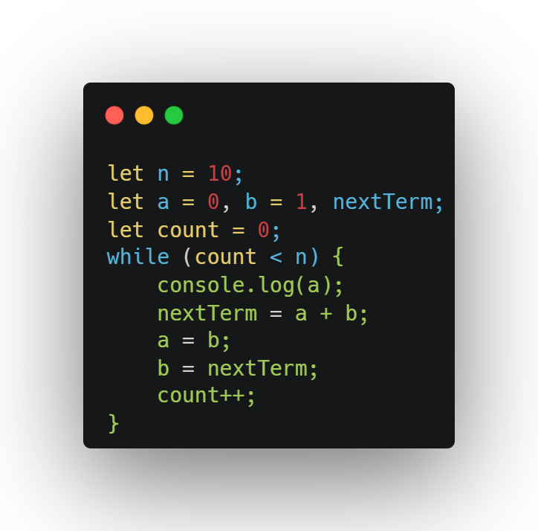
Question 5:

Slide 21
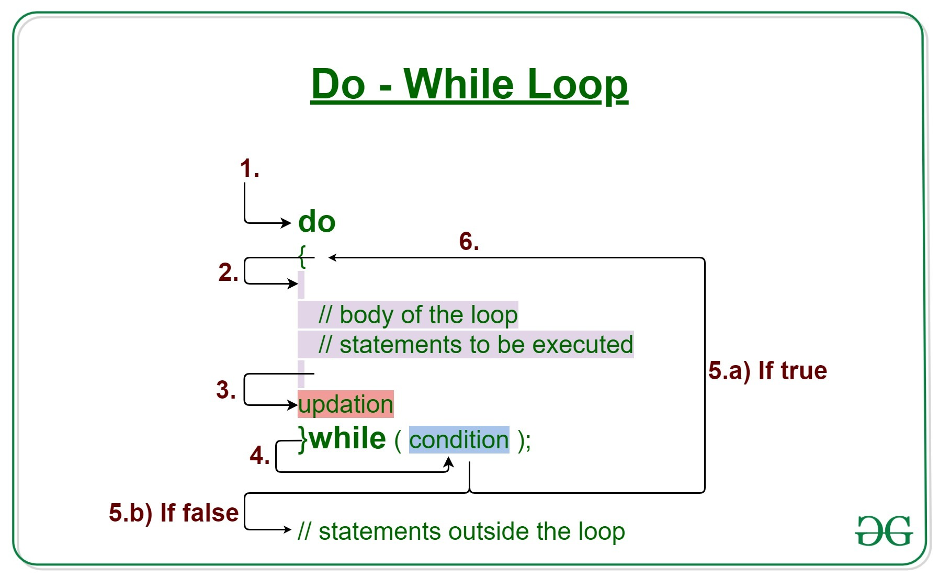
Do-While Loop

Slide 22
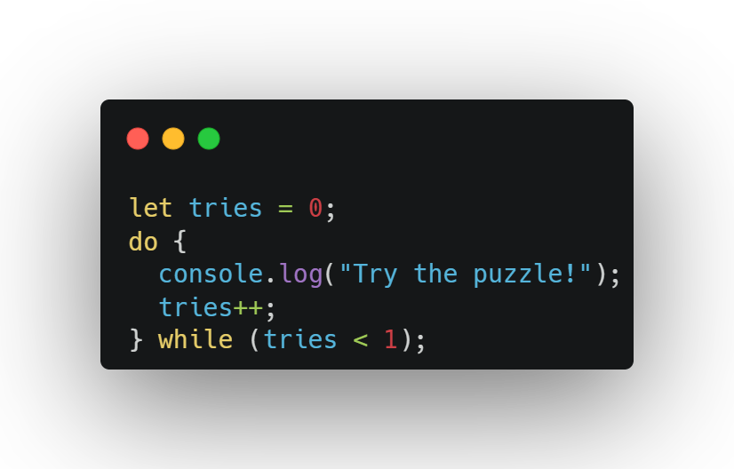
Do-While Loop

Slide 23
Why Use It?
Keep asking for a password until it’s right.
Run a game until you win.

Slide 24
Exercise

Slide 25
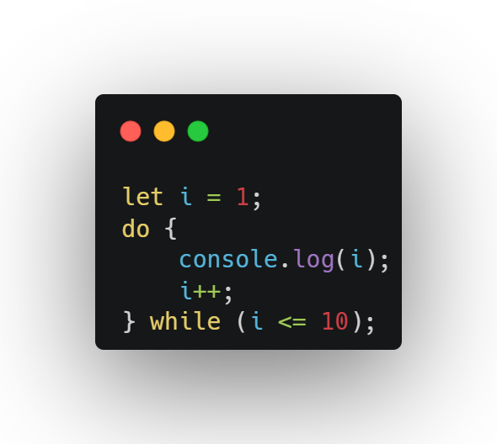
Question 1:

Slide 26
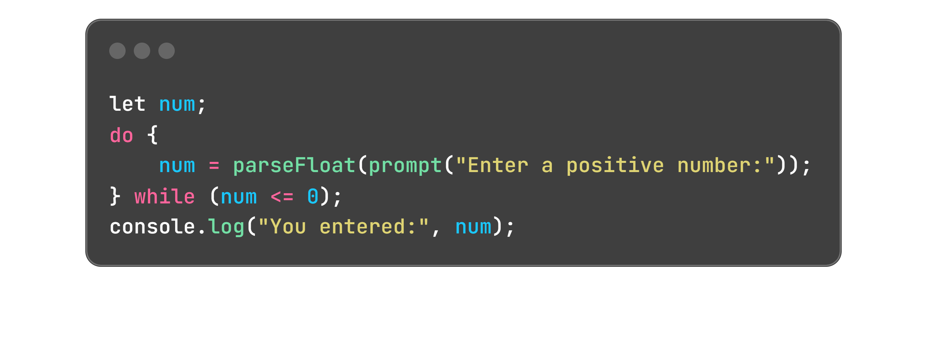
Question 2:

Slide 27
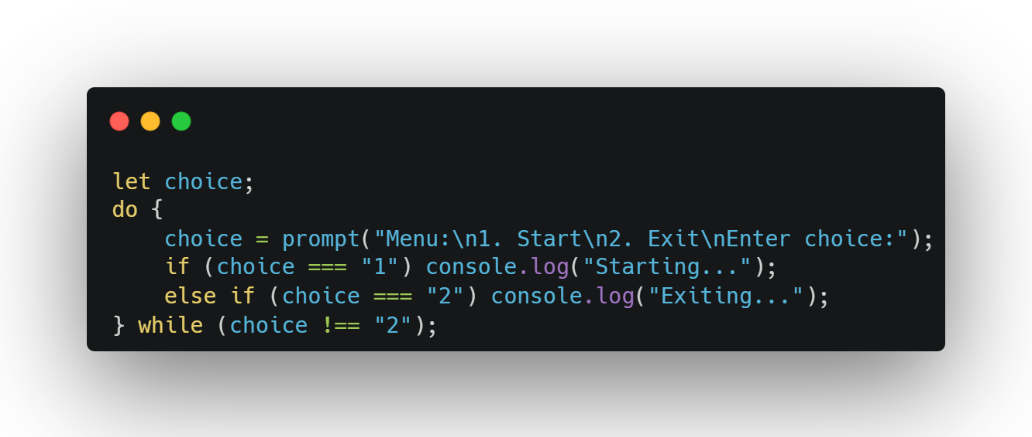
Question 3:

Slide 28
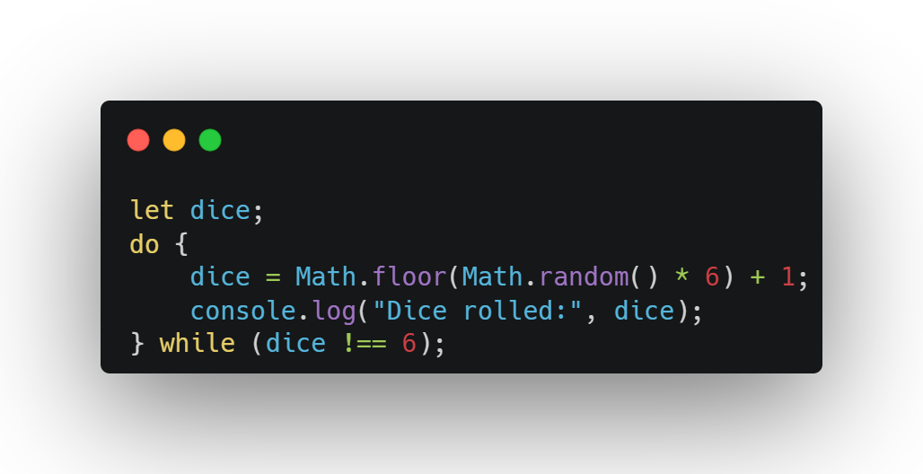
Question 4:

Slide 29
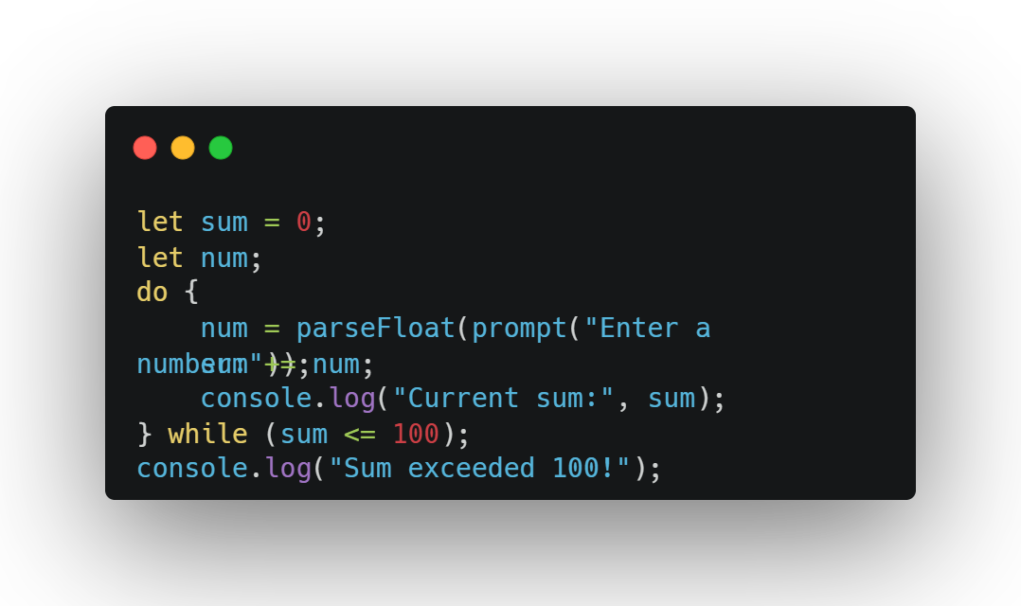
Question 5:

Slide 30
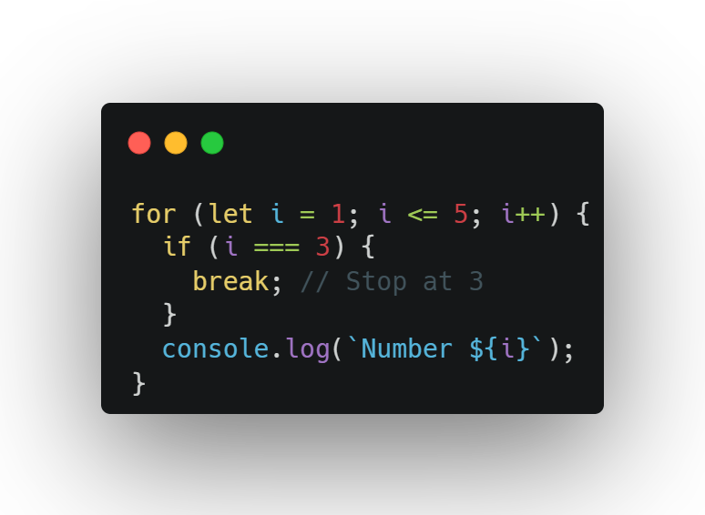
break
Stops the loop completely, like quitting a game.

Slide 31
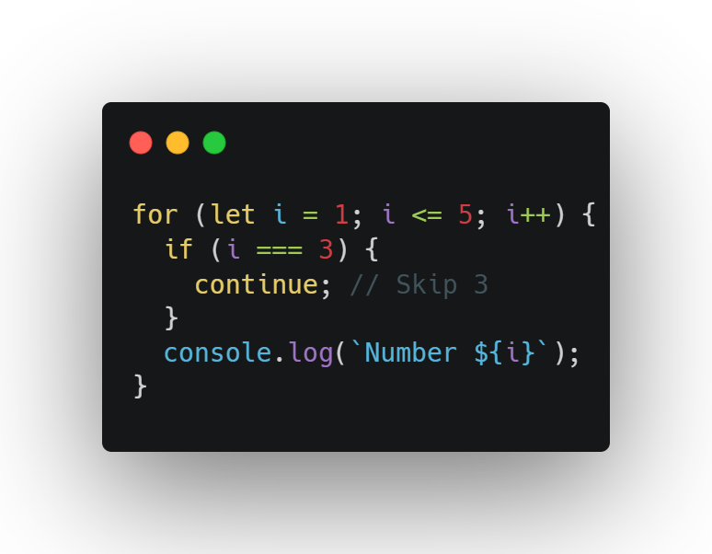
continue
Skips one step and keeps going, like skipping a boring song.

Slide 32
Why Use It?
break: Stop when you find what you want.
continue: Skip stuff you don’t want (like even numbers).

Slide 33
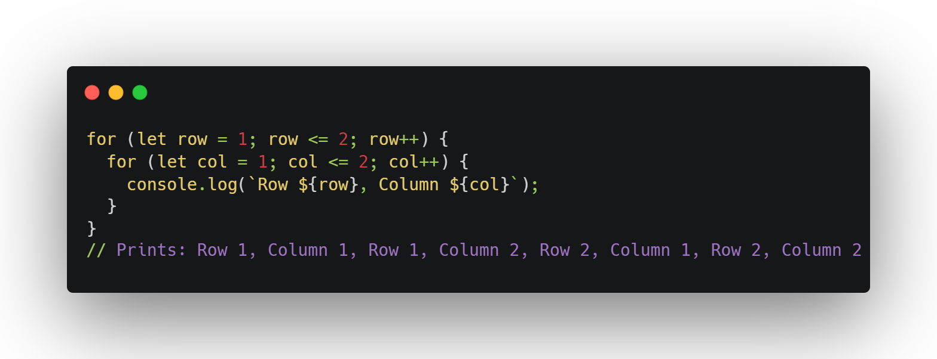
Nested Loops
A loop inside a loop, like rows and columns in a table.

Slide 34
Why Use It?
Make patterns like stars.
Build game boards (like tic-tac-toe).
Check pairs of things (like players).

Slide 35
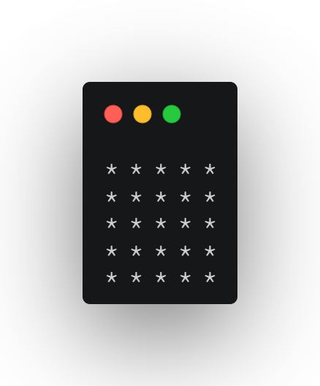
Given an integer N, print the following pattern.

Slide 36
Given an integer N, print the following pattern.
There are 4 general rules for solving a pattern-based question:
We always use nested loops for printing the patterns. For the outer loop, we count the number of lines/rows and loop for them.
Next, for the inner loop, we focus on the number of columns and somehow connect them to the rows by forming a logic such that for each row we get the required number of columns to be printed.
We print the ‘*’ inside the inner loop.
Observe symmetry in the pattern or check if a pattern is a combination of two or more similar patterns.

Slide 37
Given an integer N, print the following pattern.
Observe the Repetition
Each row has the same number of stars.
Total rows = N, and each row has N stars → so it’s a square.
Plan the Loop Logic
Use an outer loop to repeat the rows.
Use an inner loop to print N stars in each row.
String Building in JavaScript
Instead of printing star by star, create a string (row += '* ') and print it once using console.log().

Slide 38
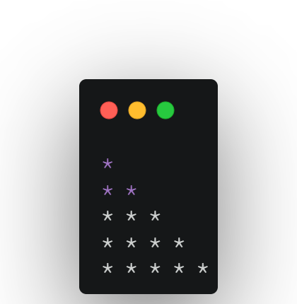
Given an integer N, print the following pattern.

Slide 39
Given an integer N, print the following pattern.
Understand the Pattern Visually Realize: the number of stars increases with each row. Row 1 has 1 star, row 2 has 2, and so on.
Decide the Number of Rows (N)
Usually, this is a fixed number or taken from user input (e.g., N = 5).
Use Two Loops:
Outer loop: goes row-by-row (from 0 to N-1).
Inner loop: prints stars for each row (from 0 to current row number).

Slide 40
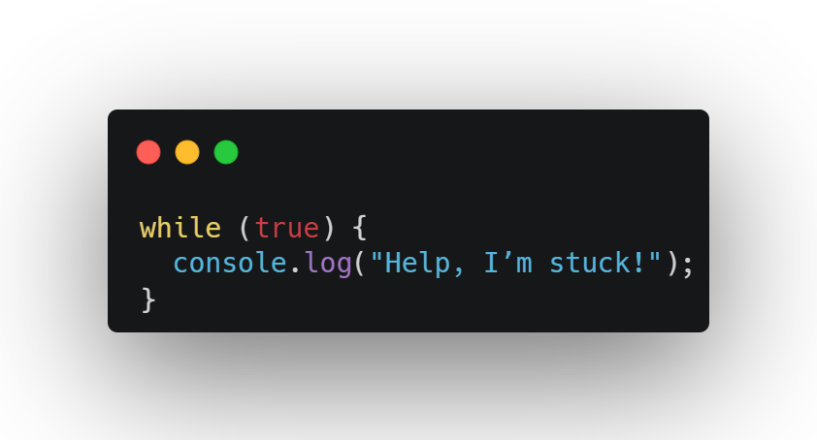
Don’t Get Stuck in Infinite Loops
A loop that never stops, like a song on repeat forever.

Slide 41
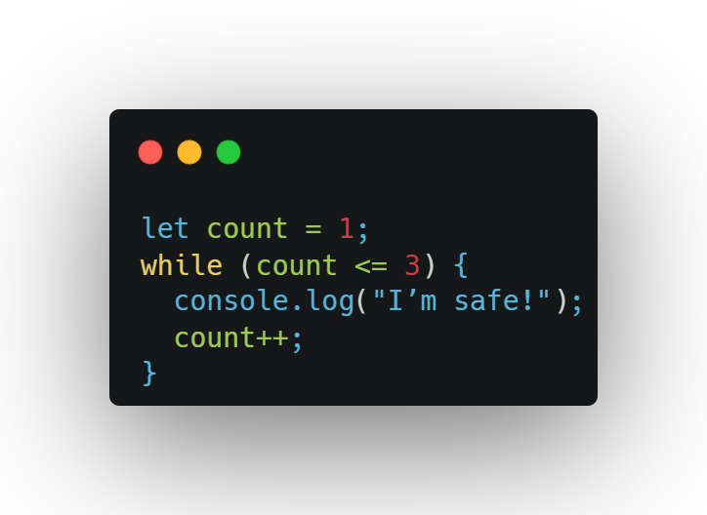
How to Stay Safe:
Make sure the condition changes.
Test with small numbers first.
Use break if you need to escape.

Slide 42
Exercise

Slide 43
Multiplication Table
Goal: Make a 3x3 multiplication table.
Use two for loops to print 1*1=1, 1*2=2, up to 3*3=9.
Output: 1*1=1, 1*2=2, ..., 3*3=9.

Slide 44
Add Numbers 1 to 10
Goal: Add numbers from 1 to 10.
Use a while loop with sum (start at 0) and num (start at 1).
Print: Sum: 55.

Slide 45
Skip Multiples of 2
Goal: Print odd numbers from 1 to 7.
Use a for loop and continue to skip even numbers.
Output: 1, 3, 5, 7.

Slide 46
Guess the Number
Goal: Guess a secret number.
Set a secret number (like 4).
Use do-while with prompt to guess until correct.
Print: You got it!.

Slide 47
Stop at 5
Goal: Stop a loop when you hit 5.
Use a for loop from 1 to 10.
Use break at 5.
Output: 1, 2, 3, 4.

Slide 48


Slide 49

Recap...
for Loop: Repeat a set number of times (like counting to 5).
while Loop: Repeat until something changes (like eating cookies).
do-while Loop: Run at least once (like trying a game).
break: Stop the loop early.
continue: Skip one step.
Nested Loops: Make patterns or grids.
Infinite Loops: Avoid by changing the condition.

Slide 50

Thank-You

